Slide 1

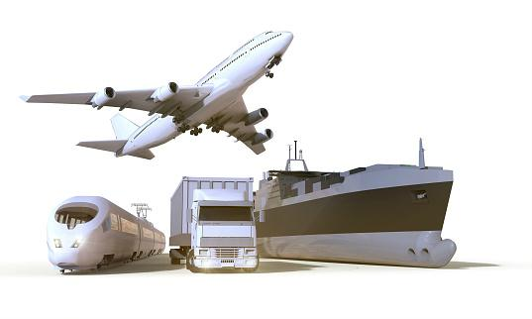
The Cost of Moving Food
Exploring Food Sustainability Through the Lens of Transport
Time, Resources, Environmental Impact and Price
Rachel Manlove
Data Analytics Capstone Project
Nashville Software School
January 2022

Slide 2

Motivation - Why I care about this topic
“Food” is a subject of great interest and passion for me: not just recipes and foodie-trends, but also in the topics of gastro-anthropology, socio-ethics, accessibility, and sustainability
I desire to live a more deliberately sustainable lifestyle, including in the decisions I make regarding the food I choose to purchase and consume
I wish to better understand the impact of the choices that I make, both in how they affect my own life, and how they affect the world around me

Slide 3

Motivation - Why you should care about this topic
Food systems (including production, processing, and transport) are one of the leading sources of global greenhouse gas emissions, accounting for nearly 35% of the global total
* Sustainable healthy diets - Guiding principles. Food and Agriculture Organization of the United Nations and World Health Organization, 2019.
As a consumer, the decisions that we make (as an individual, a family, or a food-centric business) can have a significant cumulative effect on food production prices, practices, and environmental impact
Sustainability is a hot topic of conversation right now within business and commercial institutions, academic study, government policy, geo-politics, and public interest

Slide 4
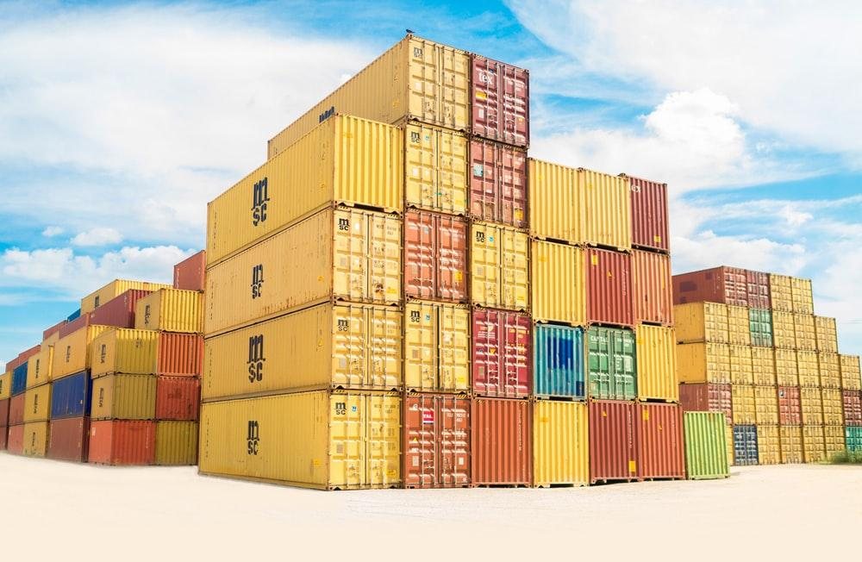
Data Questions
How fast does cargo travel via different methods?
How much fuel does it take to move one ton of cargo by these methods?
How much CO2 is produced to move one ton of cargo?
How much is spent (USD) in fuel to move one ton of cargo?

Slide 5


Approach
Find and collect data
Most data found in CSV format from US Dept. of Transportation & US Dept. of Energy
Some data found in published graphs or charts in US.gov publications, or cited by US.gov, United Nations, or peer-reviewed publications
Charts converted to csv using Adobe Acrobat
Graphs converted to csv using GetData Graph Digitizer
Some data found as text information within articles on the subject
Clean data
Drop unneeded columns and irrelevant rows
Rename select columns and variables for clarity
Reshape datasets into more useable arrangements
Fill gaps with cited data from relevant articles
Exploratory data analysis
Understand the data
Build calculated columns and queries based upon the data available to find the answers to my data questions
Data visualization
Isolate important metrics within my data, and convert the information into easily understandable visuals
Formatting and editing of visuals to maintain thematic consistency
Assembling visuals into a short presentation

Slide 6
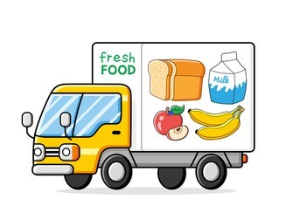
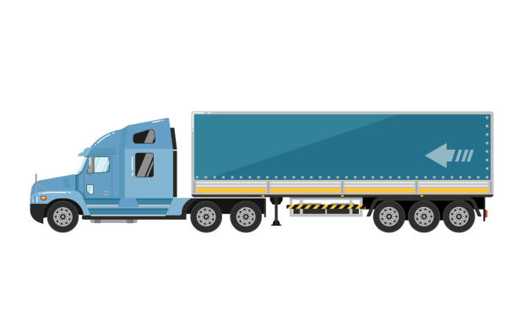
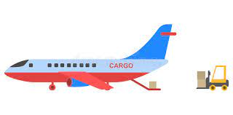
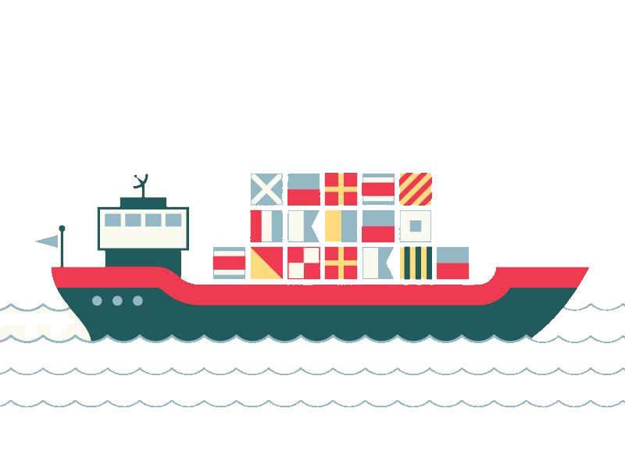
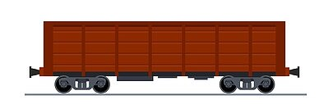
Challenges
Variable diversity within the scope of my data questions
Many of my questions center on how much fuel is consumed when moving cargo, but that depends upon the kind of fuel being used, the kind of vessel using it, and how much total weight that vessel is carrying
The data can be further complicated by a nearly infinite amount of sub-variables such as idling times, age and maintenance of the vessel, individual company policies, urban congestion, and the weather. These were not factors that I included in my data analysis, which necessitates an unknown measure of inaccuracy in my findings
Variable diversity within the data itself
Some fuel measurements were listed in tons, others in gallons. And different types of fuel weigh different amounts
Fuel consumption levels were sometimes provided by amounts of fuel consumed by day, other times by hour, and other times by distance
Speed data was listed in kilometers per hour, miles per hour, and nautical knots across different data sets and different transportation types
The weight of a shipping container, or how much weight a transport vessel is carrying, can vary significantly depending upon what is in the container, necessitating a consistent method of determining averages in cargo weights across my datasets

Slide 7
Methodology
Convert all speeds to miles per hour (MPH)
Convert all fuel measurements to gallons
Determine average weights for cargo loads - convert all to tons
For ships, ship size was given in ranges of standard TEU measurements - Twenty-foot Equivalent Unit, the size of a cargo container.
Maximum gross mass of dry goods (which excludes non-packaged liquid food cargo) per TEU is 52,910 lbs (5,140 container + 47,770 cargo). I used the total maximum weight of a TEU times the mean TEU capacity per ship-size-class to determine average ship cargo weights.
I dropped the largest size category of my dataset - 10,000+. As I had no information on what the upper ceiling was on that range, it was impossible to guess average cargo loads with any degree of accuracy.
For planes, most cargo planes are the same size and make as passenger planes, and the average size plane (Boeing 737) carries an average weight of 45,000 lbs of cargo *Smithsonian National Air and Space Museum
For trucks, my data provided maximum truck carrying weights (in lbs) by the old truck-class system (class 1-8), but my truck fuel consumption data was given using a newer government classification system of 3 categories. To determine an average cargo load of the new system, I filtered the old 8-class system into the new 3-category system and used the mean of the lower maximum weight plus the higher maximum weight within that category as the average cargo weight for trucks within that category.
For trains, I found the average non-liquid cargo load stated clearly within a published article as 30,000 tons per train
Filter all information through the lens of efficiency via ton-mile
How far a ton of cargo can travel using the different methods
Calculated by multiplying how much weight a vessel is carrying by the miles-per-gallon of that vessel
The impact of different methods of transport, measured by 1-ton of cargo

Slide 8
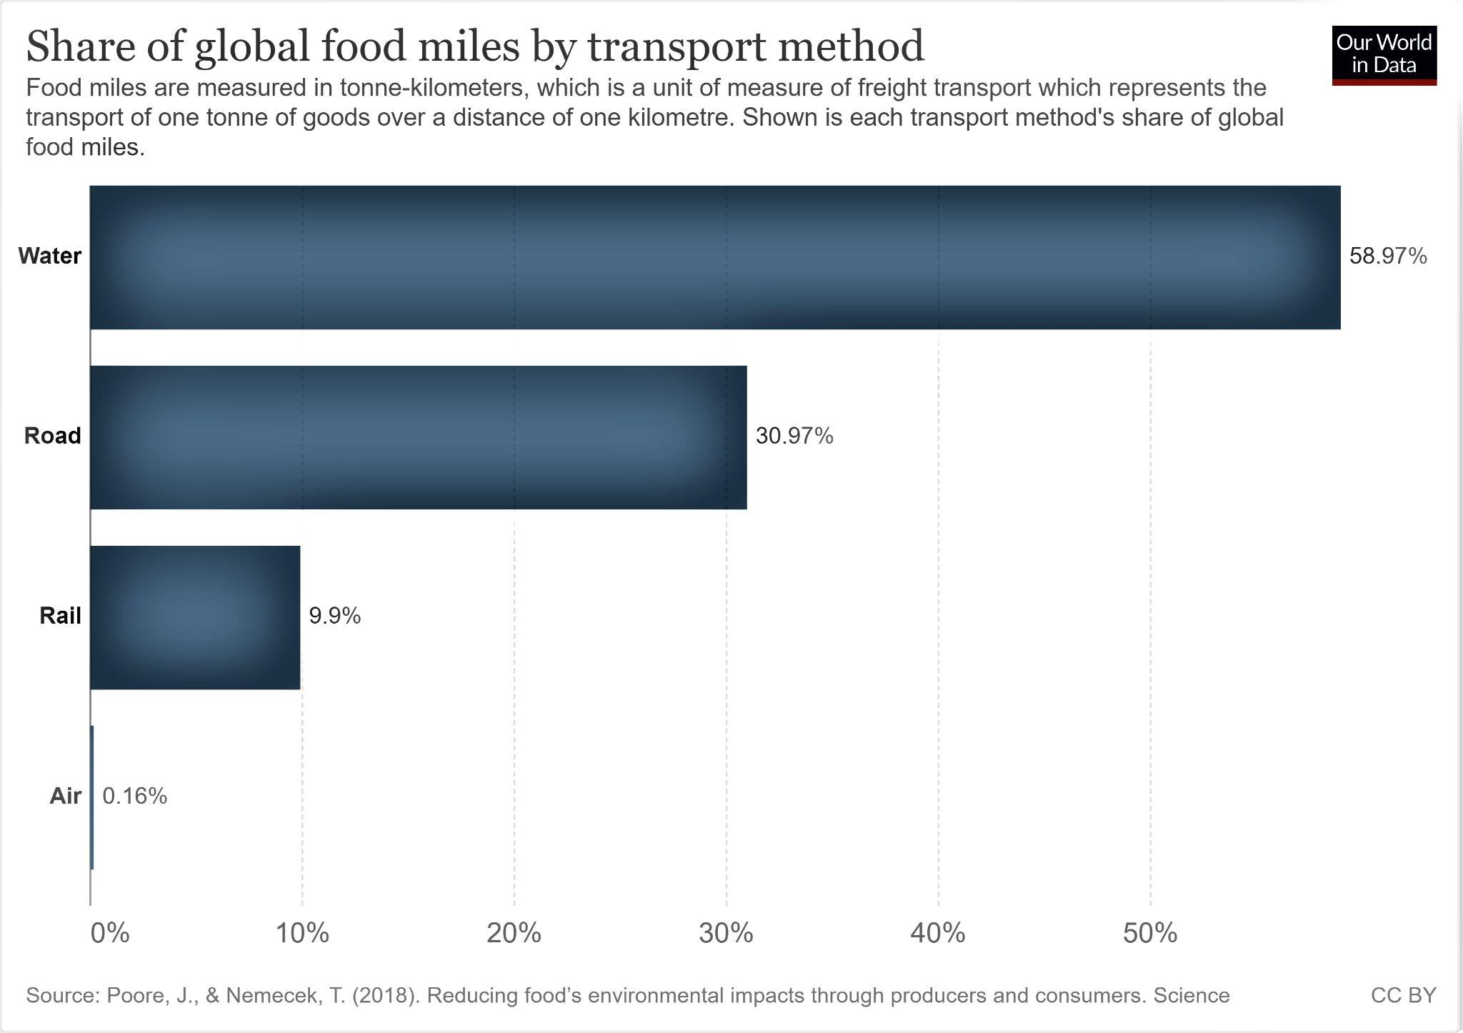
Where to start:
How does food get from the source to the market?

Slide 9
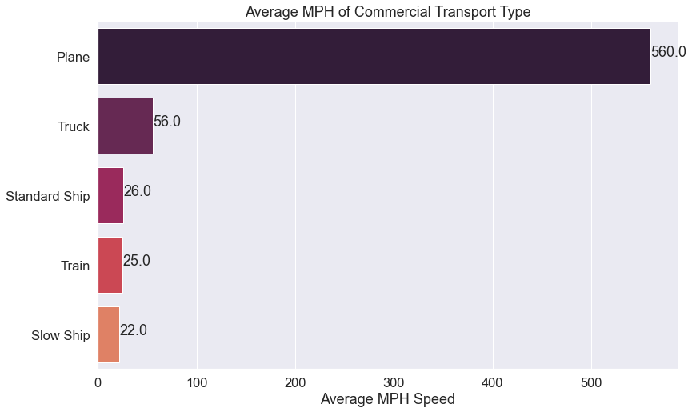
How fast does food travel by these different methods?
There is a growing trend of cargo ships traveling at lower speeds to improve fuel efficiency for each vessel
The pay-off is that it now generally takes longer to deliver goods by water AND shipping companies often have to increase the size of their fleets to meet shipping demands.
Notes:
The standard cruising speed of a cargo ship is between 20-25 knots, averaging out to about 23 knots, or 26mph. But, companies are increasingly asking their captains to travel at lower speeds - between 18 and 20 knots, or about 22mph on average, in order to save fuel.

Slide 10

How fuel efficient are these modes of transport?
How many miles per gallon (MPG) does each type get?
IT DEPENDS
Smaller Truck 10 tons 10 mpg
Larger Truck 20 tons 7 mpg
2 gallons
10 mi.
1 gallon
14 mi
Notes:
The example often given is to consider two trucks. A smaller truck that carries 10 tons of cargo and gets 10mpg. And a larger truck that carries 20 tons of cargo and gets only 7mpg. Looking at just mpg, it looks as though the smaller vehicle is more efficient - but for those smaller trucks to carry the same amount of cargo as the larger trucks, it would take another gallon of fuel vs. the larger truck’s one. MPG alone is not the best lens through which to determine fuel efficiency.

Slide 11
How fuel efficient are these modes of transport?
How many miles can a ton of cargo travel on a gallon of fuel (on average)?

Slide 12
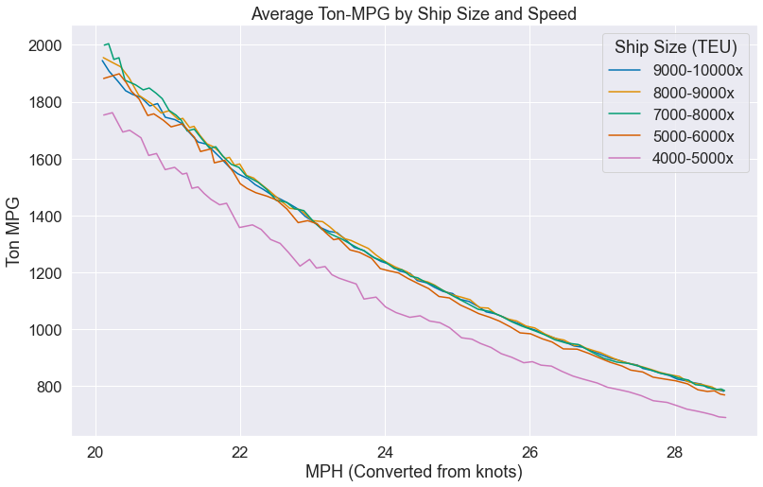
How many miles can a ton of cargo travel on a gallon of fuel (on average)?

Slide 13
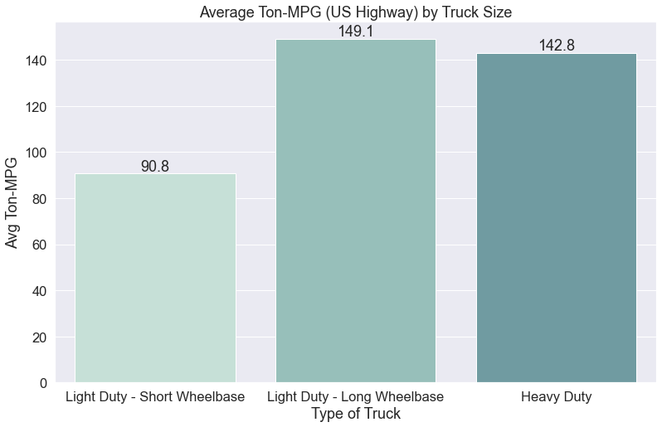
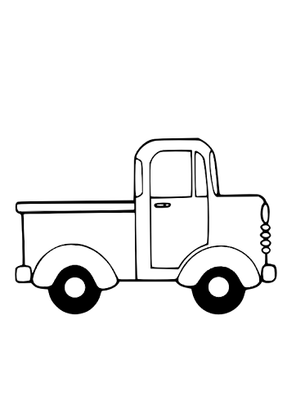


How many miles can a ton of cargo travel on a gallon of fuel (on average)?

Slide 14
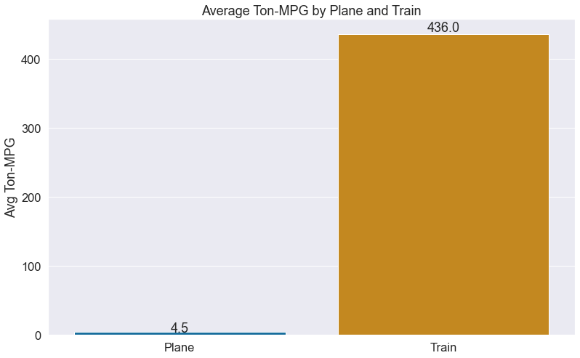
How many miles can a ton of cargo travel on a gallon of fuel (on average)?

Slide 15
What kind of environmental impact do these different methods of transport have?
The most direct impact when discussing transport, are greenhouse gas emissions from fuel consumption
Fuel = CO2
For every pound of carbon burned, three pounds of CO2 are produced
Notes:
Harmful greenhouse gasses are Carbon Dioxide, Methane, and Nitrous Oxide. With fuel, we’re primarily dealing with CO2.

Slide 16
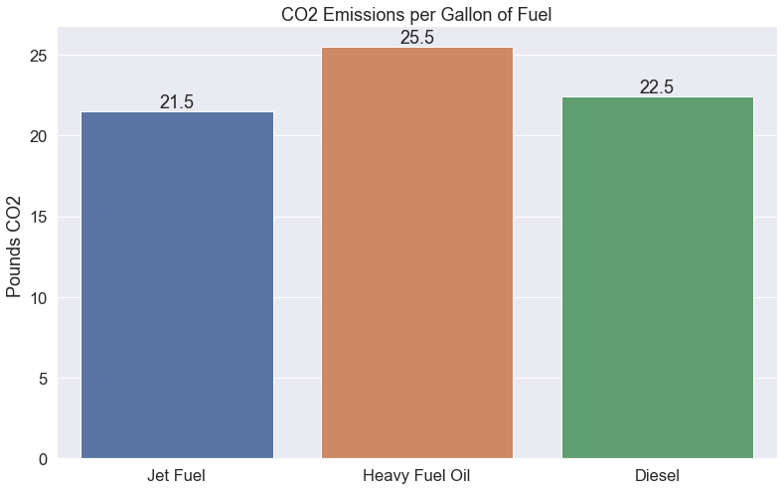


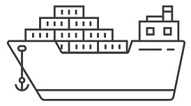

Slide 17

How much does fuel cost?

Slide 18
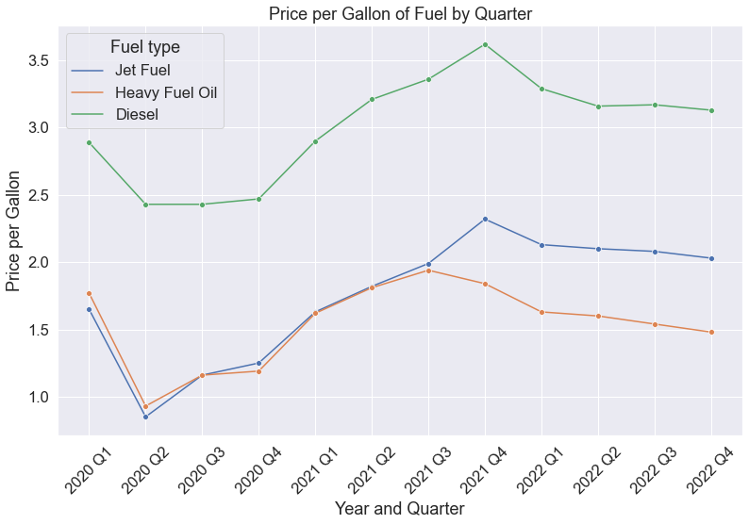
How much does fuel cost?

Slide 19
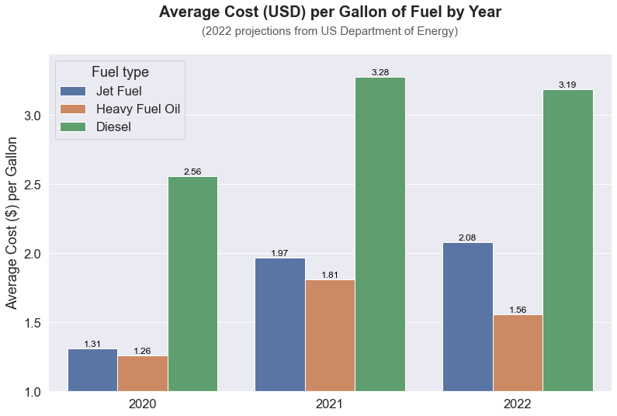
How much does fuel cost?

Slide 20
What does this all mean?
How is all this data relevant to any decisions I make?
Leopold Center for Sustainable Agriculture Iowa State University, 2001 “Food, Fuel, and Freeways: An Iowa perspective on how far food travels, fuel usage, and greenhouse gas emissions”
Average Distances from Farm to Market
Terminal Market vs. Ferry Plaza Farmers Market
Apples: 1,555 miles vs. 77 miles
Tomatoes: 1,369 miles vs. 117 miles
Grapes: 2,143 miles vs. 134 miles
Beans: 766 miles vs. 101 miles
Peaches: 1,674 miles vs. 173 miles
Winter Squash: 781 miles vs. 98 miles
Greens: 889 miles vs. 99 miles
Lettuce: 2,055 miles vs. 102 miles

Slide 21
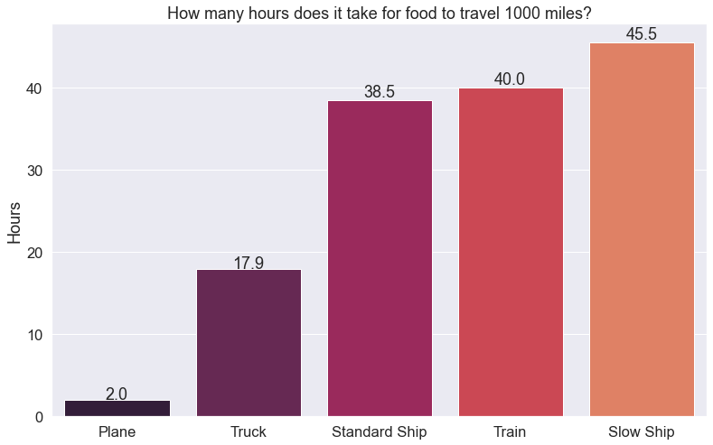

How much time does it take food to travel 1000 miles?
*1000 LAND miles- adjusted

Slide 22
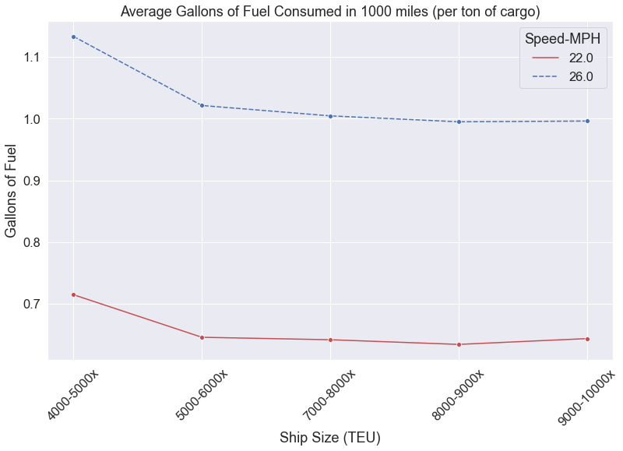
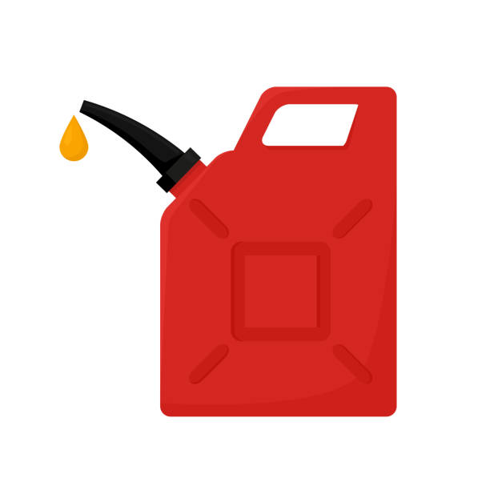
How many gallons of fuel does it take for food to travel 1000 miles?
By Ship

Slide 23
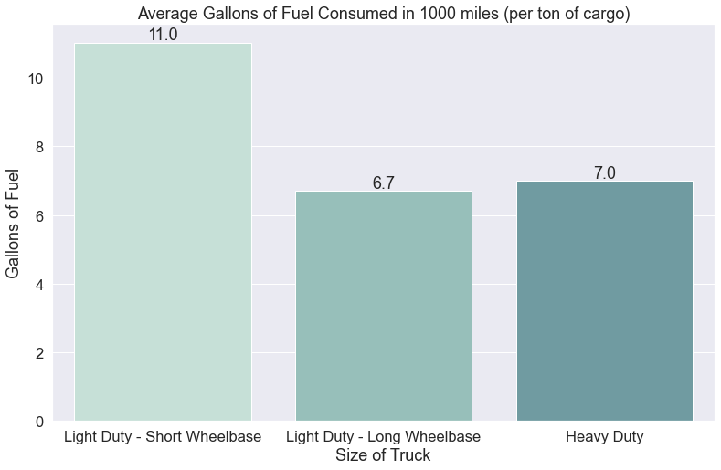
How many gallons of fuel does it take for food to travel 1000 miles?
By Truck

Slide 24
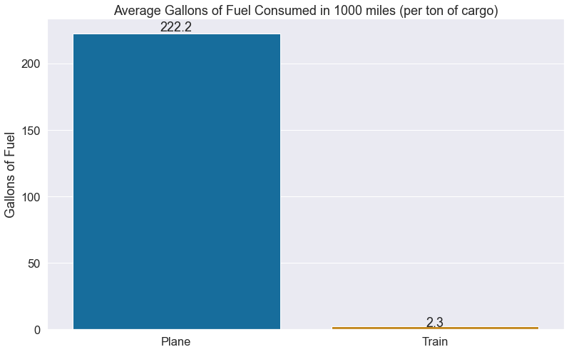
How many gallons of fuel does it take for food to travel 1000 miles?
By Train or Plane

Slide 25
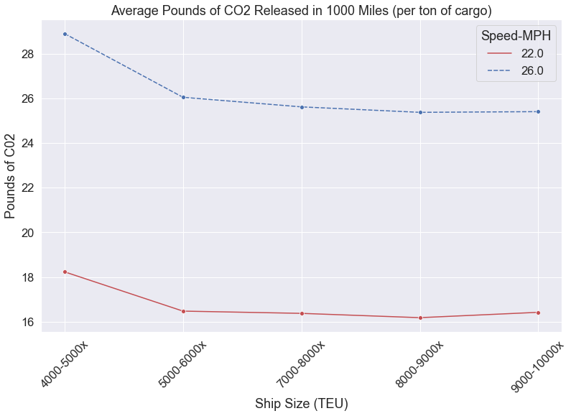

How many pounds of CO2 are produced to move food 1000 miles?
By Ship

Slide 26
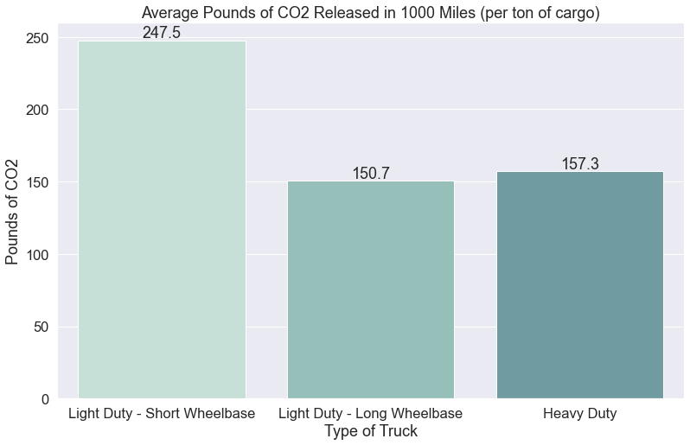
How many pounds of CO2 are produced to move food 1000 miles?
By Truck

Slide 27
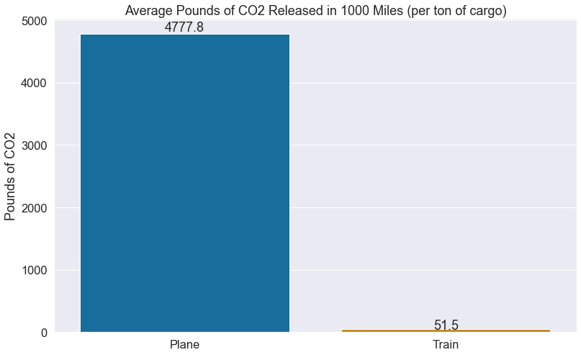
How many pounds of CO2 are produced to move food 1000 miles?
By Plane or Train

Slide 28
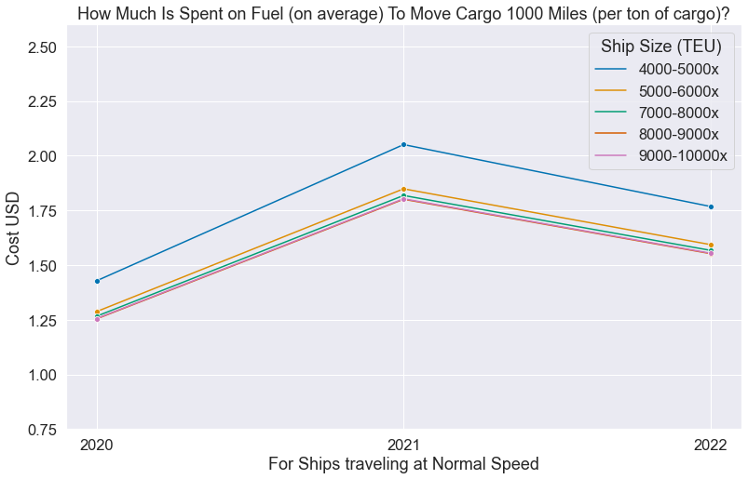
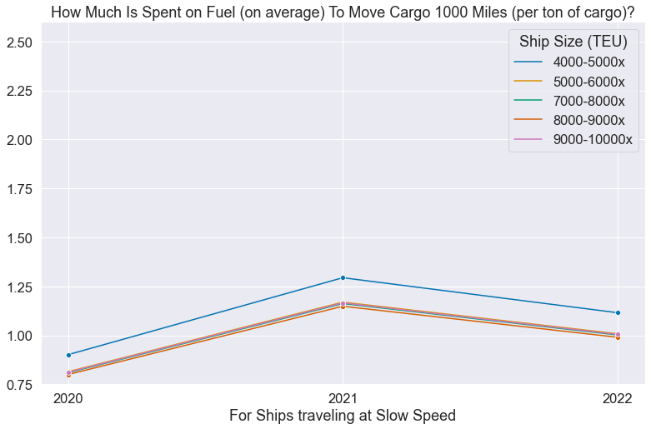
How much is spent on fuel to move food 1000 miles?
Fast Ship
Slow Ship

Slide 29
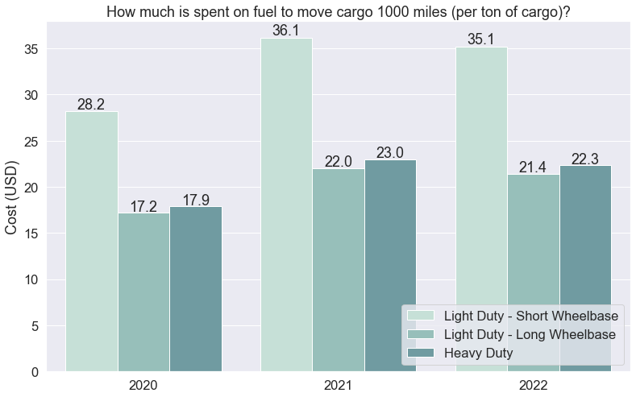
How much is spent on fuel to move food 1000 miles?
By Truck

Slide 30
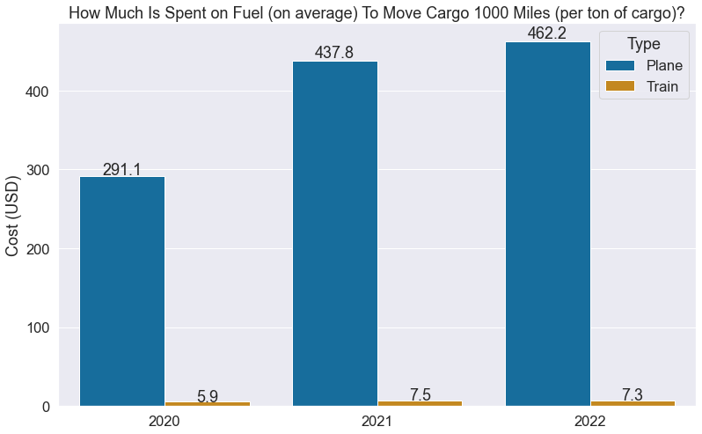
How much is spent on fuel to move food 1000 miles?
By Plane or Train

Slide 31
What’s the best method (1-Ton/1000 miles)?
Fast Ship
Slow Ship
Small Truck
Medium Truck
Big Truck
Plane
Train
Time (Hours)
38.5
45.5
17.9
17.9
17.9
2
40
Gallons of Fuel
.99
.63
11
6.7
7
222.2
2.3
CO2 (lbs)
25.37
16.18
247.5
150.7
157.3
4777.8
51.5
Fuel cost 2021
1.80
1.15
36.14
22.00
22.97
437.78
7.52
Is this really the best option?
Notes:
For the ships, I chose the best mileage from all 5 size categories.
So, if you’re looking to move food over long distances, the best method is by a slow-moving ship.

Slide 32
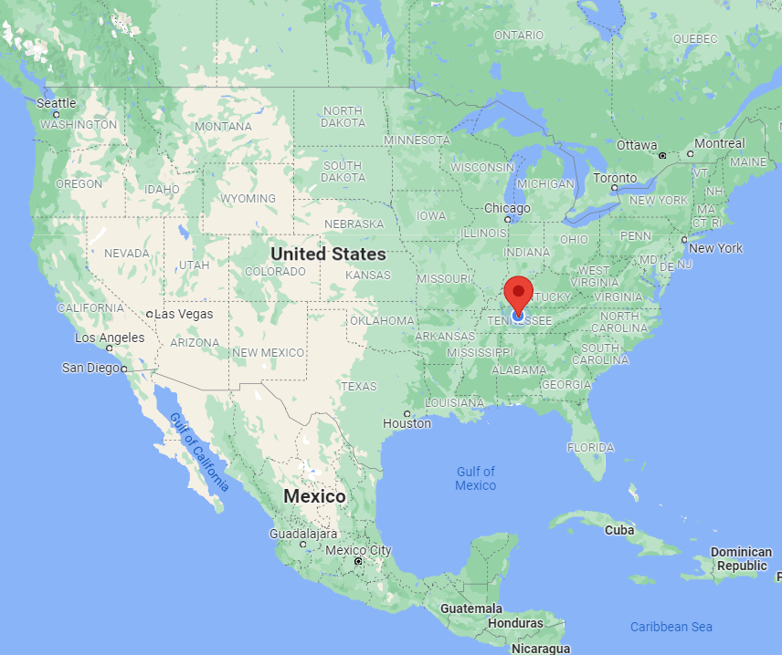
Fast Ship
Slow Ship
Small Truck
Medium Truck
Big Truck
Plane
Train
Time (Hours)
38.5
45.5
17.9
17.9
17.9
2
40
Gallons of Fuel
.99
.63
11
6.7
7
222.2
2.3
CO2 (lbs)
25.37
16.18
247.5
150.7
157.3
4777.8
51.5
Fuel cost 2021
1.80
1.15
36.14
22.00
22.97
437.78
7.52
Is this really the best option?
Notes:
In general, yes. If you need to move large amounts of food across large distances, boat is the way to go

Slide 33
Fast Ship
Slow Ship
Small Truck
Medium Truck
Big Truck
Plane
Train
Time (Hours)
38.5
45.5
17.9
17.9
17.9
2
40
Gallons of Fuel
.99
.63
11
6.7
7
222.2
2.3
CO2 (lbs)
25.37
16.18
247.5
150.7
157.3
4777.8
51.5
Fuel cost 2021
1.80
1.15
36.14
22.00
22.97
437.78
7.52
Is this really the best option?
Notes:
In general, yes. If you need to move large amounts of food across large distances, boat is the way to go. If you need to cross water.
Across land, trains are the next best method. You can’t carry quite as much by cargo train as by cargo ship (about 30,000 tons vs 120,000 tons - for the smaller ships), but in terms of impact and cost, it is the second best option.

Slide 34
Transporting food by Ship or Train
Pros:
Fuel efficient over long distances
Cons:
Slow
Less CO2 production - by cargo weight
Ship and Train is not the end point of that cargo’s journey
Effective at moving large amounts at once
Food most likely processed or under-ripe: less nutritious *unless frozen

Slide 35
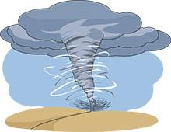
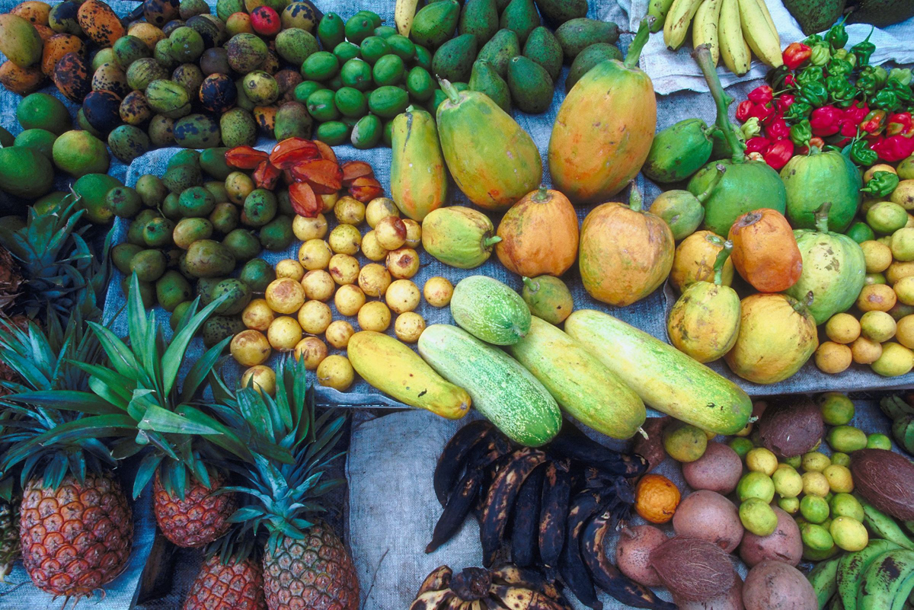










Globalization

Slide 36
Areas for Further Analysis
Refine the data for transit by truck by including data for urban driving conditions
It would be fascinating to further examine where exactly different ingredients are grown and how exactly they’re transported, to get a clearer vision of a food-product’s journey from origin to market
Shipping ports mapped
Rail lines mapped
Distribution centers highlighted

Slide 37
Data Sources
U.S. Department of Transportation (National Freight Statistics)
U.S. Surface Transportation Board (Rail Service Data)
U.S. Department of Energy (Motor Vehicle Mileage, Fuel Consumption, and Fuel Economy)
U.S. Department of Energy (Short-Term Energy Outlook, December 2011)
U.S. Department of Energy (Carbon Dioxide Emissions Coefficients by Fuel)
The Geography of Transport Systems, by Jean-Paul Rodrigue (Fuel Consumption by Containership Size and Speed)
The Conservation Fund (Moving Freight: Economy and Atmosphere)
The National Air and Space Museum (How Things Fly)

Slide 38
Questions
?

